Slide 1


Slide 2
PROGRAMMING FUNDAMENTAL
FINAL PROJECT
1ST SEMESTER

Slide 3

THE GIPSY PAD
A SIMPLE TEXT EDITOR
SUBMITTED BY :
INDERPREET SINGH
ROLL NO-CO18325
SUBMITTED TO: SUDHAKAR SIR

Slide 4

INTRODUCTION
The main aim of this project is to provide user a simple text editor with graphical touch.
This project is built using GTK which is written completely in C LANGUAGE.
The name is GIPSY is given on the name of GIPSY AVENGER from the movie PACIFIC RIM
Gipsy Avenger honors the heroic legacy of her namesake as the flagship leader of the Mark VI fleet. More than just a Jaeger, she is a symbol of hope to millions.

Slide 5

GTK(GIMP TOOLKIT)
GTK (GIMP Toolkit) is a library for creating graphical user interfaces. It is licensed using the LGPL license, so you can develop open software, free software, or even commercial non-free software using GTK without having to spend anything for licenses or royalties.
It's called the GIMP toolkit because it was originally written for developing the GNU Image Manipulation Program (GIMP), but GTK has now been used in a large number of software projects, including the GNU Network Object Model Environment (GNOME) project. GTK is built on top of GDK (GIMP Drawing Kit) which is basically a wrapper around the low-level functions for accessing the underlying windowing functions . The primary authors of GTK are:
Peter Mattis
Spencer Kimball
Josh MacDonald
GTK is essentially an object oriented application programmers interface (API). Although written completely in C, it is implemented using the idea of classes and callback functions (pointers to functions).

Slide 6
FEATURES OF MY PROJECT
It is a simple text editor which includes:-
1)OPTION TO OPEN A FILE
2)CREATE A NEW FILE
3)SAVE AND EDIT A FILE
4)TOOLBAR WHICH CONTAINS ICONS FOR USEFUL FUNCTIONS
5)SPECIAL ICON FOR THE EDITOR

Slide 7
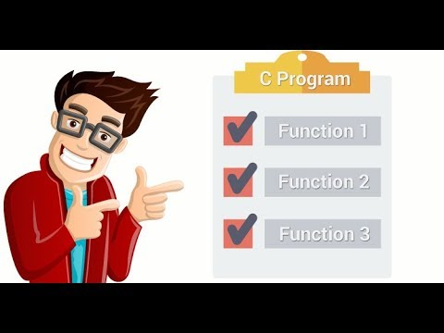
FUNCTIONS USED IN MY PROGRAMME
open_dialog
Save_dialog
About_label
Create_pixbuff
Main

Slide 8

THE WAY I PROCEEDED

Slide 9
FORMATION OF A BLANK WINDOW
FORMATION OF MENU ITEM-1:FILE
FORMATION OF A VBOX
FORMATION OF MENU ITEM-2:HELP
FORMATION OF A MENU BAR
SET TITLE FOR THE EDITOR(OR WE CAN SAY FOR THE BLANK WINDOW)
FORMATION OF SUBMENU IN THE FILE MENU---OPEN,SAVE AND NEW
FORMATION OF A TOOLBAR
TILL NOW WE HAVE JUST CREATED BUTTONS AND MENU ITEMS WITHOUT ANY FUNCTION THUS A BASIC LAYOUT OF THE EDITOR HAS BEEN FORMED
FORMATION OF SUBMENU IN THE HELP MENU---ABOUT
ADDITION OF SAVE BUTTON,OPEN BUTTON,NEW BUTTON AND EXIT BUTTON
CONNECTING THE SUBMENU WITH MENU ITEM USING gtk_menu_shell_append
INSERTION OF BUTTONS TO THE TOOLBAR USING gtk_toolbar_insert

Slide 10
FORMATION OF A TEXT BOX WHICH WRITES IN BUFFER ie FORMATION OF GtkTextBuffer
FORMATION OF about_label FUNCTION WHICH GIVES SOME INFORMATION ABOUT THE EDITOR
SO NOW THE USER CAN WRITE,COPY,PASTE TEXT IN THE EDITOR BUT STILL CANNOT OPEN ANY FILE OR MAKE ONE AND SAVE IT
FORMATION OF open_dialog FUNCTION WHICH IS USED TO OPEN A FILE IN THE EDITOR
FORMATION OF save_dialog FUNCTION WHICH IS USED TO SAVE A NEW FILE OR AN EDITED FILE
NOW WE HAVE FORMED ALL THE NECESSARY FUNCTIONS.
CONNECTING SUB MENU-ABOUT WITH THE FUNCTION about_label USING g_signal_connect
CONNECTING SUB MENU-OPEN WITH THE FUNCTION open_dialog USING g_signal_connect
AFTER THIS A USER CAN OPEN,SAVE OR FORM A NEW FILE ALSO SO WE COULD HAVE CONSIDERED OUR EDITOR TO BE COMPLETE UNTIL I FOUND THAT FILE WITH LARGE DATA WAS NOT READ COMPLETELY DUE TO NON-AVAILABILITY OF “SCROLLER WINDOW”.
CONNECTING SUB MENU-SAVE WITH THE FUNCTION save_dialog USING g_signal_connect
CONNECTING SUB MENU-NEW WITH THE FUNCTION main USING g_signal_connect
CONNECTING TOOLBAR BUTTON OPEN WITH THE FUNCTION open_dialog USING g_signal_connect
CONNECTING TOOLBAR BUTTON SAVE WITH THE FUNCTION save_dialog USING g_signal_connect
CONNECTING TOOLBAR BUTTON NEW WITH THE FUNCTION main USING g_signal_connect

Slide 11
FORMATION OF SCROLLER WIDGET USING gtk_scrolled_window_new
NOW OUR EDITOR IS COMPLETELY READY FOR USE BUT IT DOESN’T HAVE ANY ICON
ADDITION OF AN .ico FILE AS THE ICON USING FUNCTION create_pixbuf
ADDITION OF TEXT BOX TO SCROLLER WINDOW USING gtk_container_add
ADDITION OF SCROLLER WINDOW TO VBOX USING gtk_container_add
FORMATION OF A GDK PIXBUF ICON
SET THE ICON AS ICON OF THE WINDOW BY USING gtk_window_set_icon
WITH THIS OUR EDITOR IS COMPLETELY READY AND FUNCTIONAL

Slide 12
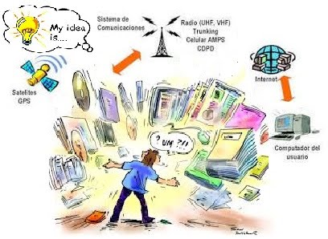
SOURCES OF INFORMATION
https://developer.gnome.org/
http://zetcode.com/gui/gtk2/
https://www.gtk.org/tutorial1.2/gtk_tut.html#toc14
GTK+ Tutorials on YouTube
Teachers and fellow classmates

Slide 13
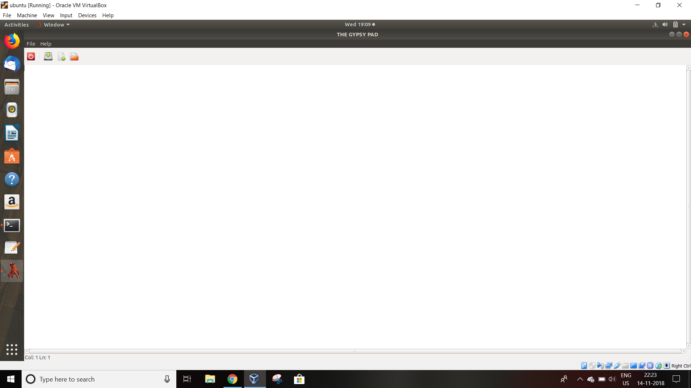

Slide 14
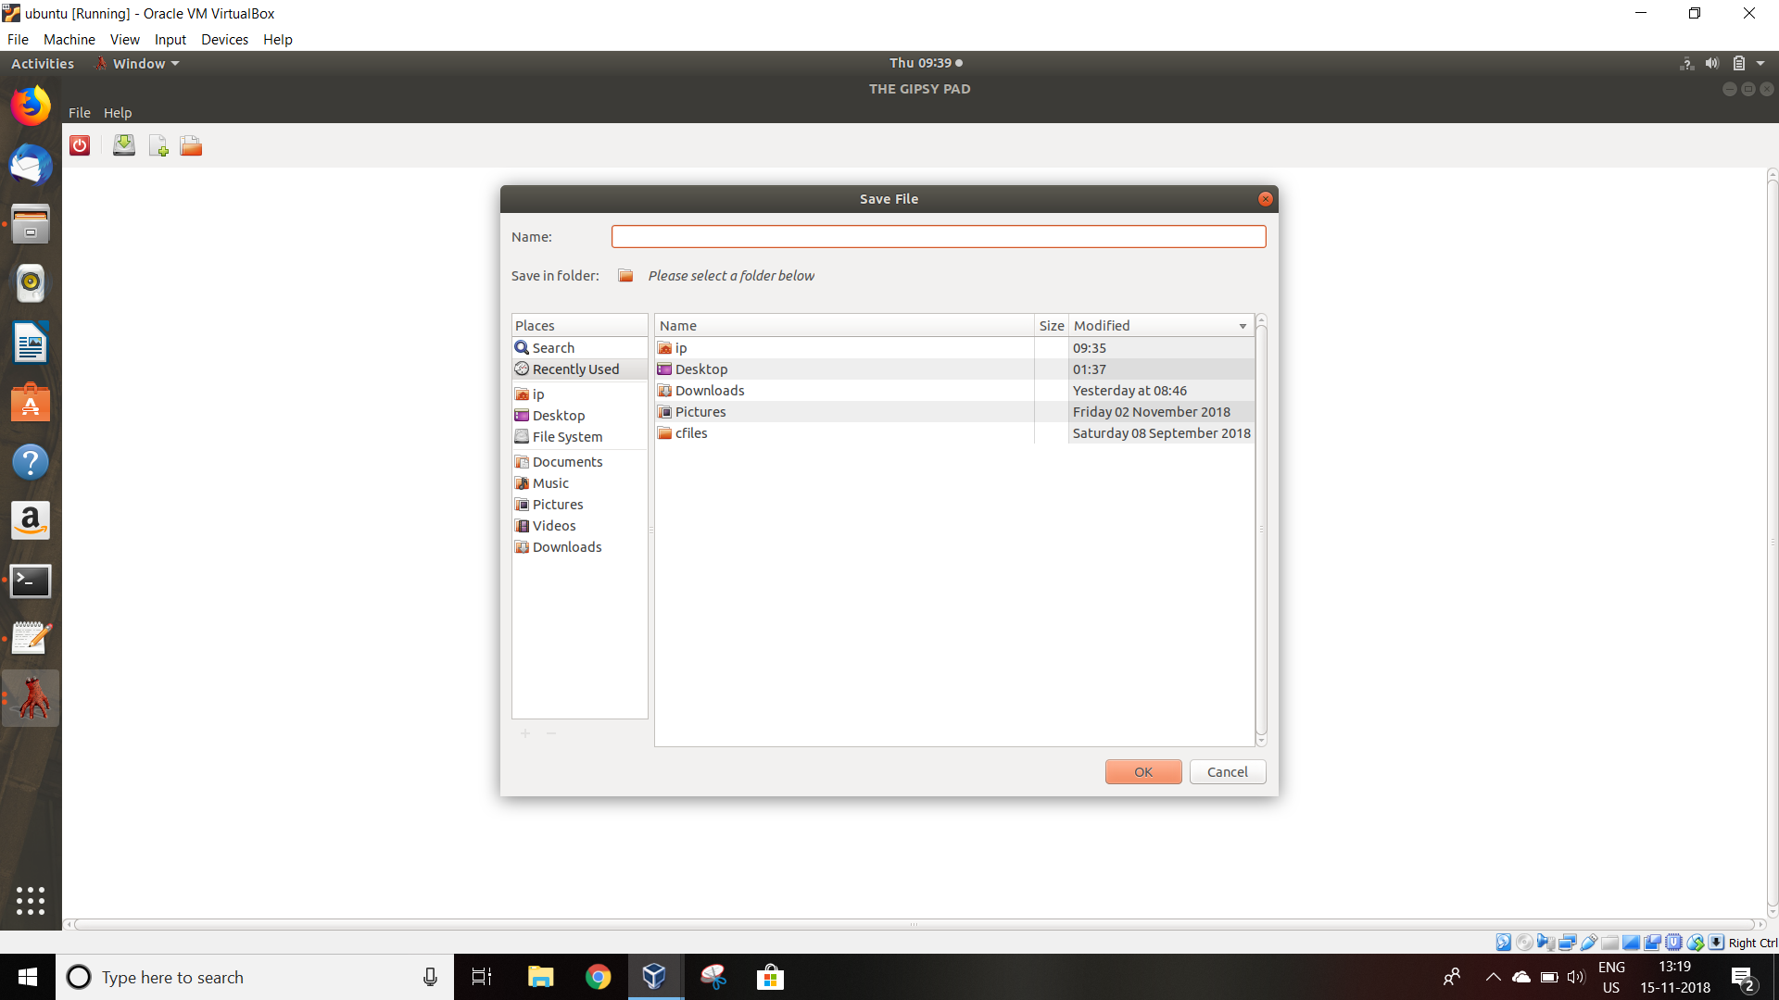

Slide 15
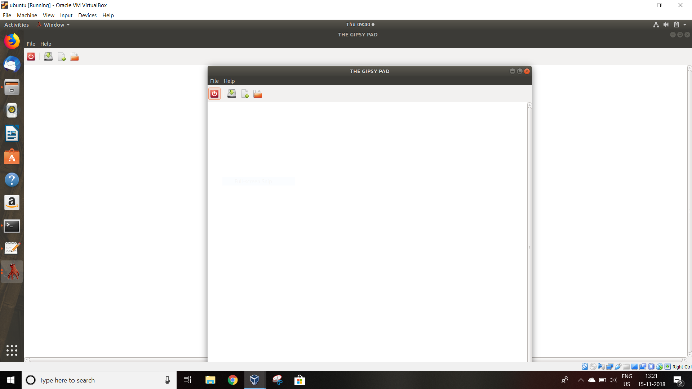

Slide 16
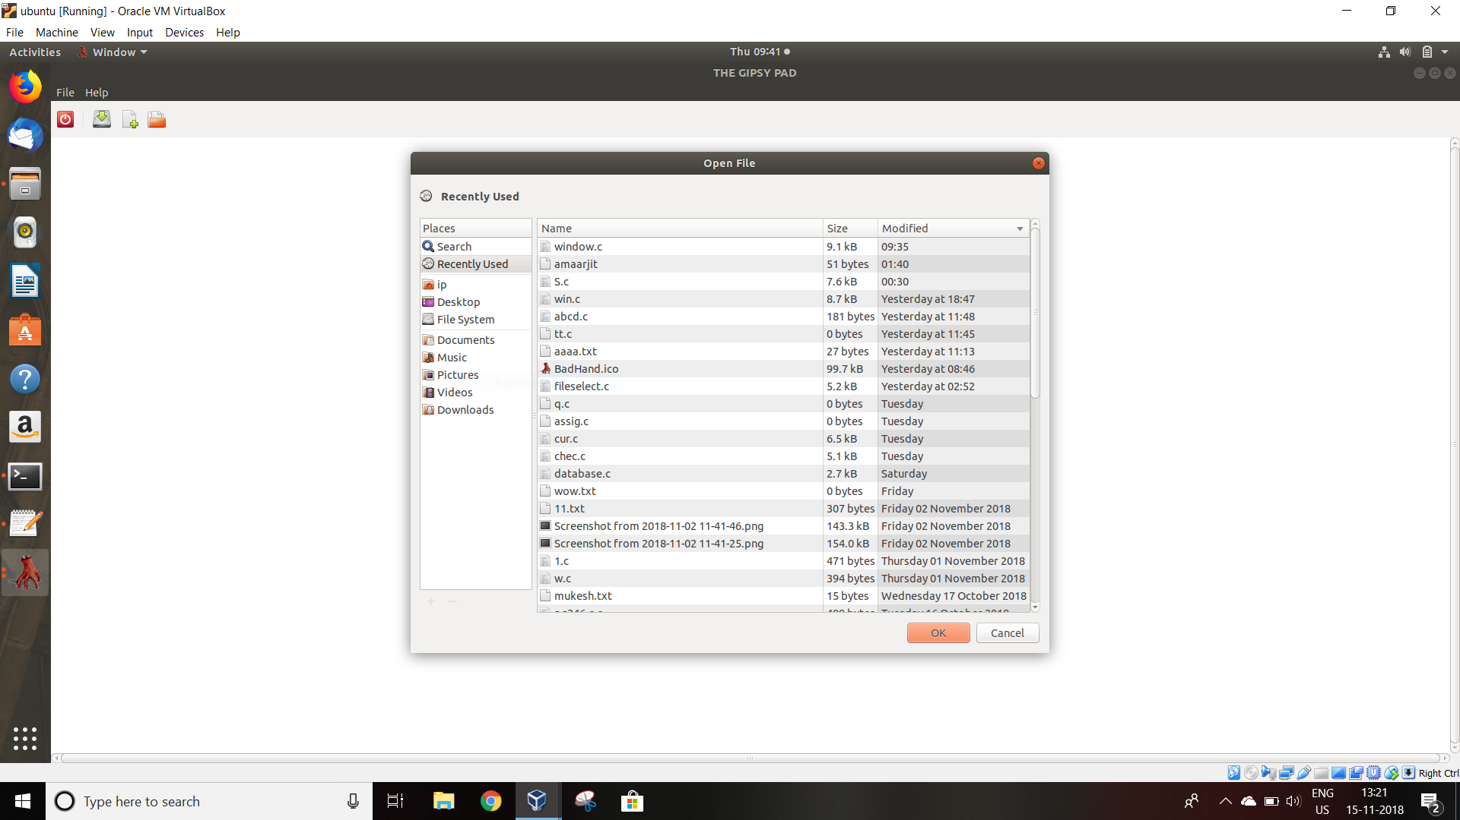

Slide 17
THANK YOU

